Slide 1

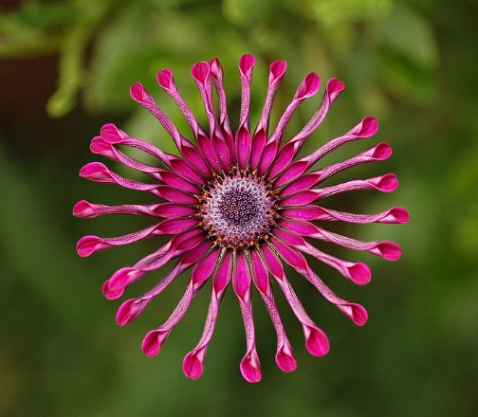
Welcome

Slide 2
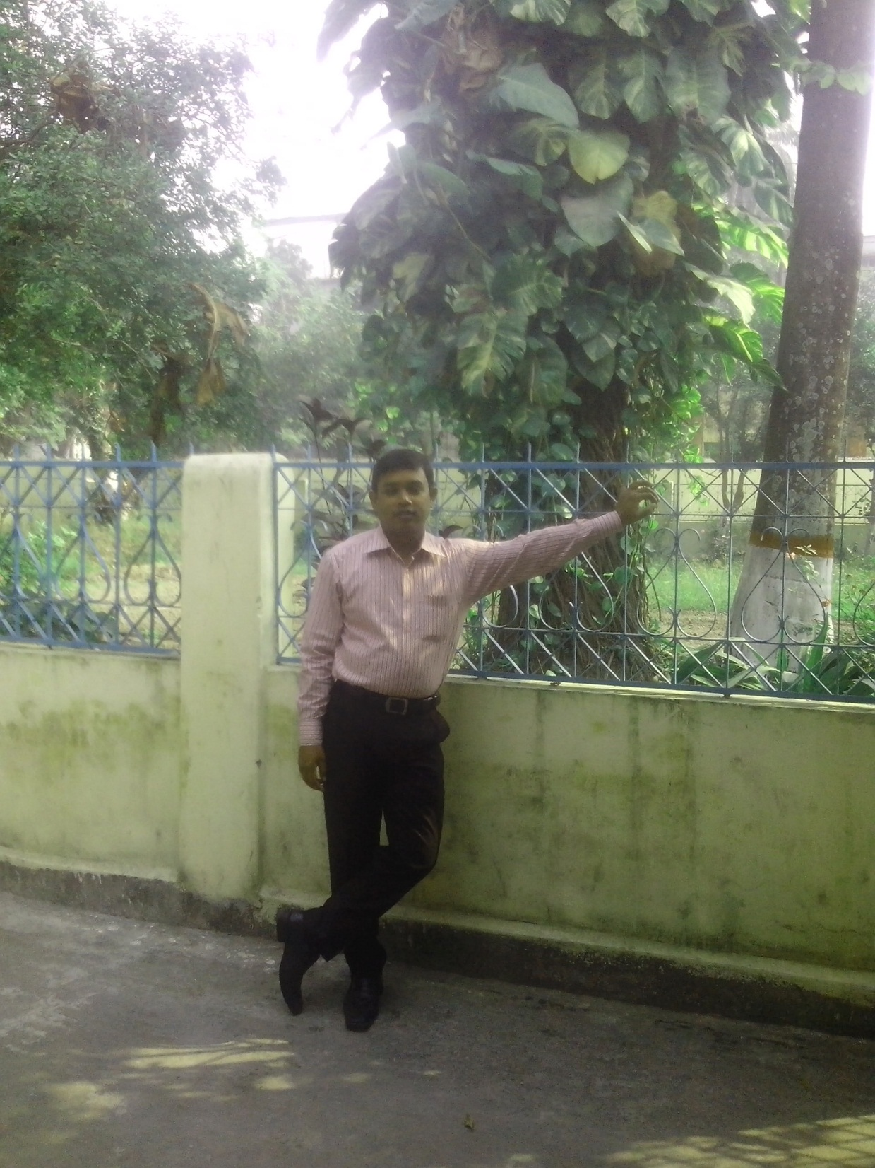
Introduction of teacher
MD:Isahaque ali.
Assistant Teacher.
Subject:English.
Khatlal pilot girls high
school and college.
Khatlal joypurhat.
ID-no-11
Email:Isahaquealiuzzal@gmail.com

Slide 3

Introduction of lesson
Class: Eight
Subject: English [first paper]
Unit: 1
Lesson: 1
Time: 45 minutes
Date: 14/12/2013

Slide 4
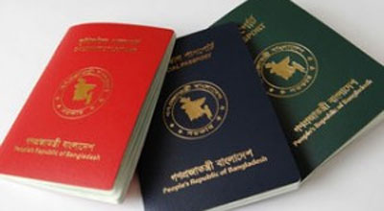
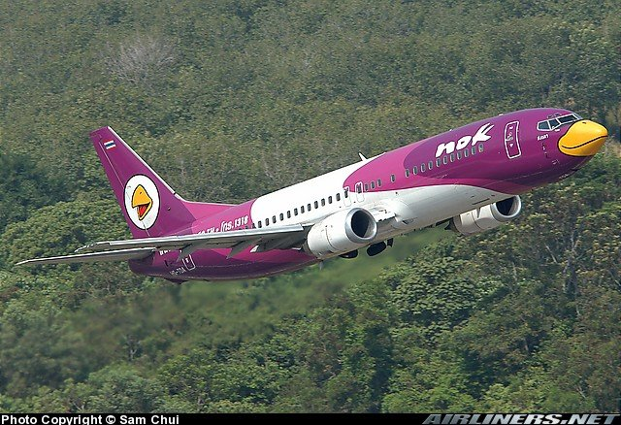
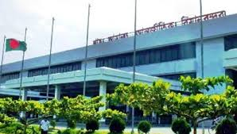

Look at the pictures and now describe what you guess.
Pasport
aeroplane
airport
In side of Aeroplane

Slide 5

Lesson title
Going on a foreign trip

Slide 6
Learning out comes
By the end of the lesson, the students will be able to.
1.Describe the picturs and video.
2.Write vocabulary.
3.Summerise the topic.

Slide 7
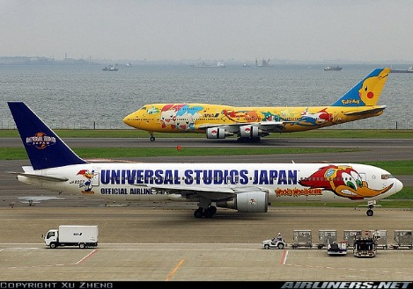
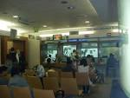
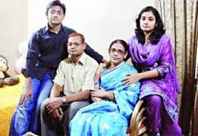
vocabulary
Airport
immigration
Family

Slide 8

Silent reading

Slide 9
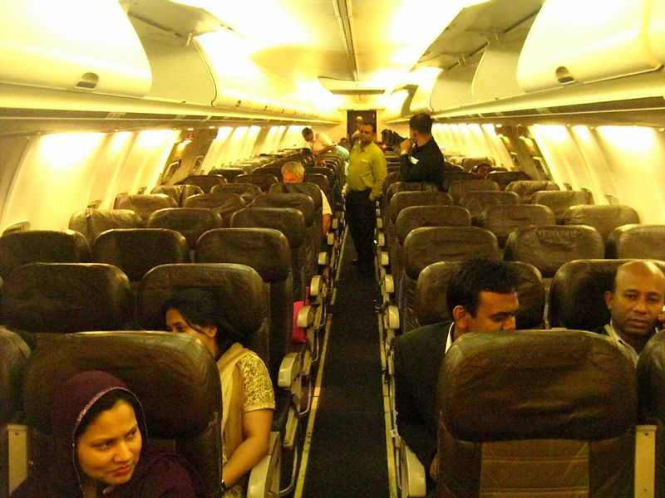
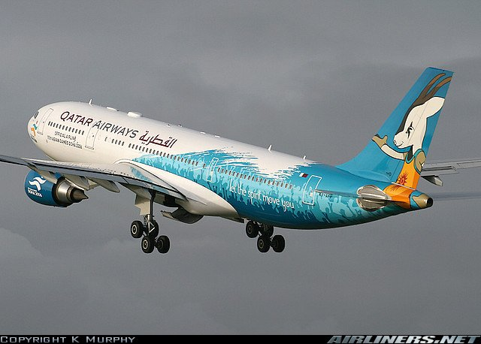
Individual work
Write a short note on picture?

Slide 10

Solution
Zara and her parents live in London. She wants to visit of Bangladesh. So, they buy their air ticket and took theair seat in site the Arroplane. The arroplane is flying on the sky now. And they are happy.

Slide 11

Pair work
Write the answer of following question?
1.What did they decide?
2.Who are at the H: S: I:Airport?
3.Who start filling in the form?

Slide 12

Solution
1.They decided to go Thailand.
2.Mita,Zara and her parents are at the H.S.I. Airport.
3.Mita,Zara and her parents start filling in the form.

Slide 13
Group work
Write summery about
‘’Going on a foreign trip’’

Slide 14
Solution
Mita and Zara are decided to go London.
So,they are waiting at the H. S. I. Airport.
The immigration officer will check their passport.

Slide 15
Evaluation
1.Where does Zara live?
a.Bangladesh b.London c.China d.Japan
2.Where they are waiting?
a.House b.plane c.loung d.airport
3.Who brings form?
a.Zara b.Meta c.Mitas father d.Mitas uncie

Slide 16

Home Work
Describe about your experience of
travelling to another place

Slide 17

Thanks

